Slide 1





NATURAL LANGUAGE
PROCESSING
PROJECT BY:
ZAINEH MIHYAR 22110203

Slide 2


TABLE OF CONTENT
01
UNDERSTAND THE DATA
02
PREPROCESSING STEPS
03
WORD REPRESENTATION TECHNIQUES
04
TRADITIONAL & NEURAL MODELS

Slide 3
specialty_id | name_ar | question_body
23 | طب عيون | استشاره عيون
14 | جراحة العظام والمفاصل | عندي نقص فيتامين د هل ممكن استخدم معه كالسيوم
14 | جراحة العظام والمفاصل | ألم بالكتف الايسر من فترة
... | ... | ...
18 | طب اسنان | اريد التحدث مع طبيبب اسنان
14 | جراحة العظام والمفاصل | هل ممكن يدكتور ان تتم عمليه اعاده الكسر بسبب ت...
23 | طب عيون | زوجتي تعاني من ضعف النظر درجة ٤.٥
23 | طب عيون | ابي استفسر عن النظاره الطبيه للعيون
THE DATASET CONSISTS OF 3 COLUMNS:
SPECILITY_ID
NAME_AR (TARGET)
QUESTION BODY (PATEINT QUESTION)
IT HAS 92559 RECORDS

Slide 4
name_ar | Count
جراحة العظام والمفاصل | 25475
الطب النفسي | 18625
طب اسنان | 18624
طب عيون | 16045
تغذية | 13790
THE DATA IN “NAME_AR” IS IMBALANCED WHERE “جراحة العظام والمفاصل” IS 25475, AND “تغذية” IS 13790, WHICH IS ALMOST HALF OF IT.
SO, AFTER REMOVING DUPLICATES, WE WILL CHECK IF IT’S STILL IMBALANCED OR NOT AND SOLVE IT.

Slide 5
PREPROCESSING

Slide 6
PREPROCESSING STEPS
01
ADD LANGUAGE COLUMN
02
02
DROP IRRELEVANT ROWS
03
PREPROCESSING
04
BALANCE DATA

Slide 7
LANGUAGE COLUMN
I used the langid library to automatically detect the language of each question.
The language code was stored in a new column “Language”.

Slide 8
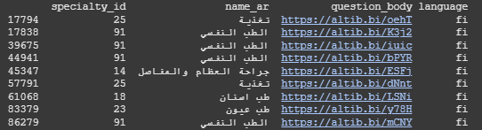
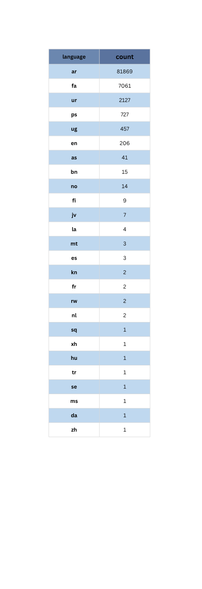
These are the detected languages mostly Arabic.
Each language doesn’t explicitly has a language, for example “fi” has urls.

Slide 9
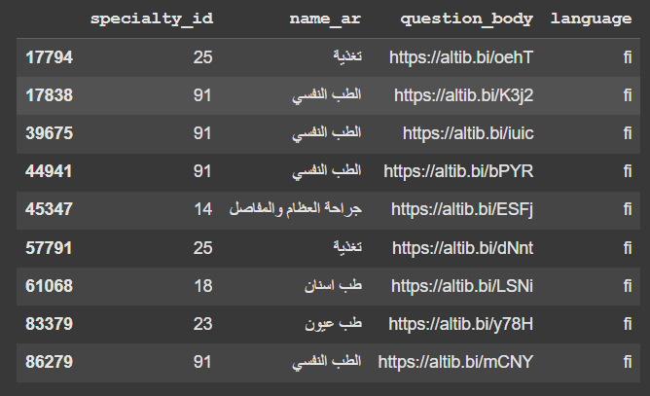
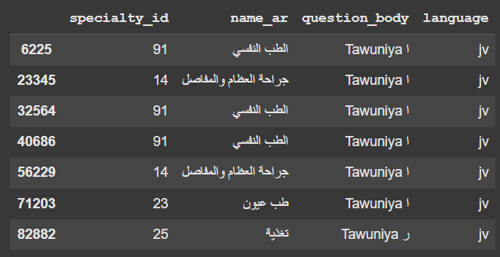
So I dropped the following languages
‘fi’, ‘jv’, ‘bn’, ‘as’, ‘se’, ‘tr’, ‘zh’, ‘hu’, ‘nl’, ‘kn’, and ‘mt’. Because they contain noise and they are non-informative. Keeping them would confuse tokenizers and embedding models, lead to meaningless or misleading features, and mislead the model training and evaluation. So removing them would improve the data quality and ensure the model trains only on valid, meaningful input

Slide 10
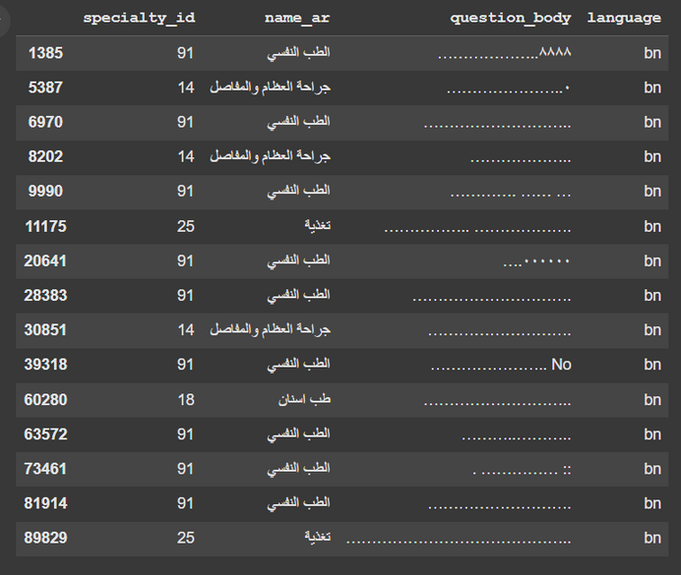
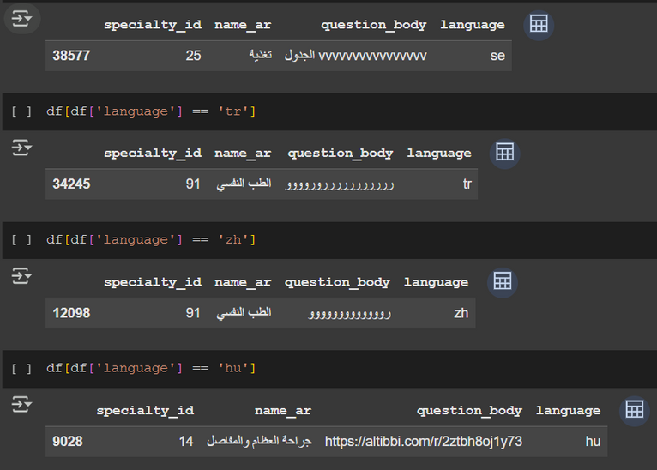
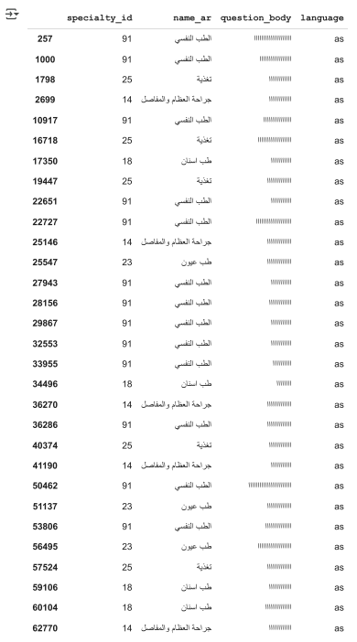
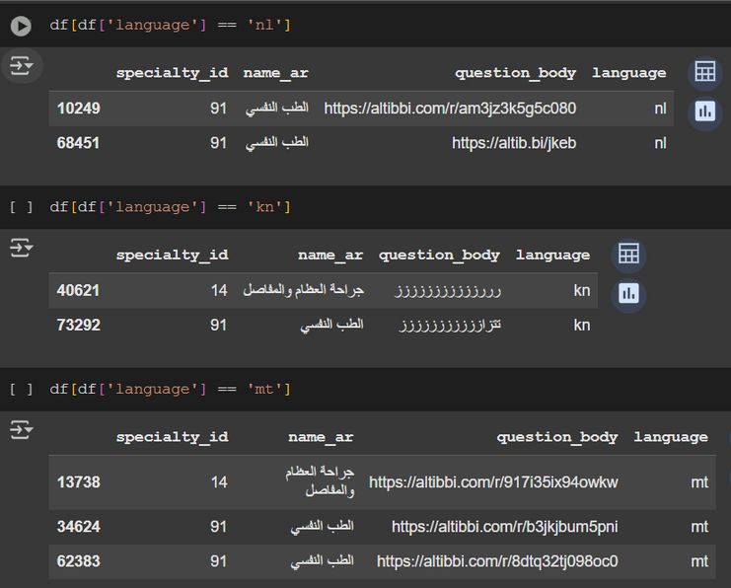

Slide 11
DROPPING IRRELEVANT ROWS
I dropped duplicated rows, and then manually scanned the dataset to see if there were irrelevant rows.
Cleaning noise improves embedding quality and focuses the model on medical information.

Slide 12



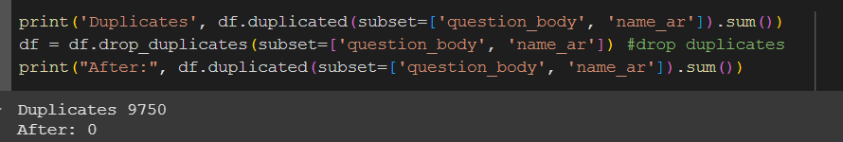
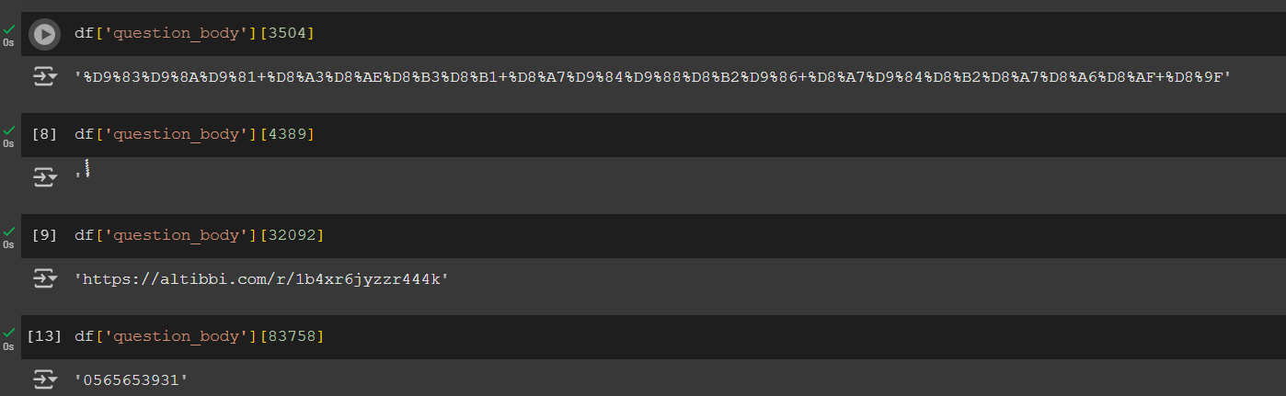

Slide 13
PREPROCESSING

Slide 14
TRANSLATION
The project aimed to use Arabic-language data for embedding and model training. However, the dataset included multilingual inputs, including English and French. Since users may submit questions in any of these languages, dropping non-Arabic rows was not an option, since we want the model to handle other languages.
One solution was to detect the language of each sentence and then apply language-specific preprocessing: using English stop words and stemmers for English sentences, and Arabic stemmers and stop words for Arabic ones. However, this approach is not scalable, especially as unexpected languages may appear in the data, making it difficult to maintain language-specific pipelines and increasing the system complexity and maintenance overhead.

Slide 15
TRANSLATION
To address this challenge, a more scalable solution was implemented: a code that detects non-Arabic words within a sentence and automatically translates them to Arabic. This approach preserves the original semantic content of the question while aligning it with the expected language format of the model, ensures all inputs are in a consistent language (Arabic), which is critical for models trained on Arabic embeddings and allows the use of a single, Arabic-optimized pipeline for tokenization, stemming, and embedding, significantly simplifying preprocessing.
Translation improves model performance by reducing noise and language mismatches during embedding, it handles multilingual data without manual language classification or multiple pipelines, it retains more usable data compared to dropping multilingual rows, and in a healthcare application, retaining and correctly interpreting multilingual user queries is crucial for inclusivity and reliability.

Slide 16


ARABIC CHARACTER NORMALIZATION
Arabic words often have multiple surface forms. For example, "إلم" and "الم" may represent the same word. Normalizing these ensures token consistency.
Reduces vocabulary size.
Improves classification accuracy by avoiding feature sparsity.

Slide 17
REMOVING HARAKAT
Harakat are optional diacritics in Arabic that change pronunciation but rarely affect meaning in standard written text. So removing it makes the input clearer and more standardized.

Slide 18
REMOVING NUMBERS
Numbers are often irrelevant. Prevents meaningless tokens (like IDs, phone numbers) from affecting model predictions.

Slide 19
REMOVING ENGLISH LETTERS AND WORDS
Although translated sentences may still contain mixed Arabic-English words (“سيكبw”), this occurs due to translation limitations with slang or domain-specific terms.

Slide 20
TOKENIZATION
Tokenization breaks text into words, which are the input units for most NLP models. Important for downstream tasks (embedding, classification), and allows selective stopword removal and stemming.

Slide 21
STOPWORD REMOVAL
Stopwords are high-frequency words with low semantic value. I created a custom stopward list, for words that are frequent but semantically uninformative. Removing them improves model focus on informative words, and helps reduce dimensionality and sparsity in traditional ML models.
(“السلام عليكم”) They do not contribute to the medical meaning of the question. Keeping them would increase noise and make embeddings focus on irrelevant context. “Tawuniya” is an insurance company It does not help with classifying the medical specialty of a question. Its presence across many samples can bias the model without adding useful information.

Slide 22


STEMMING
Why stemming instead of lemmatization?
Lemmatization aims to return the dictionary form of a word, while stemming reduces words to their root or base form. Lemmatization is more useful when exact word meanings are needed (e.g., in translation or question answering). I chose stemming because:
In the classification task, the focus is on capturing general patterns across different word forms, not the exact dictionary form.
Lemmatization tools for Arabic are limited, slower, or less accurate in handling noisy, short-form medical queries.
Stemming provides faster, lightweight, and reliable results for large-scale text classification.

Slide 23
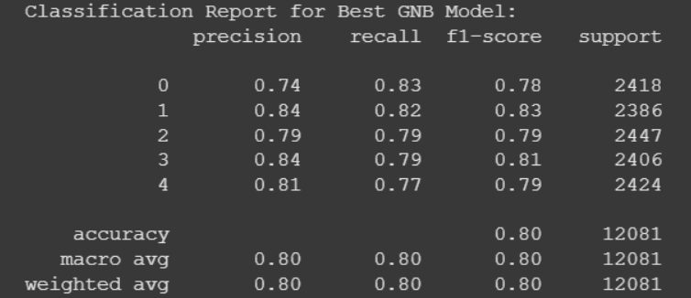
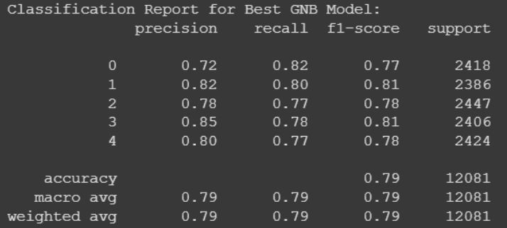
STEMMERS
I compared 2 Arabic stemmers Farasa and Iris stemmers.
FARASA
IRIS
Farasa, the model achieved accuracy = 0.80
ISRI, the model dropped slightly to accuracy = 0.79

Slide 24
FARASA STEMMER
How does Farasa work?
Removes affixes (prefixes, suffixes) based on Arabic morphological rules. It uses a trained model to identify root-like forms while avoiding over-stemming. It retains more semantic meaning compared to ISRI, which sometimes strips too much and damages interpretability.
Why Farasa is a better choice?
It has better accuracy, it handles modern standard Arabic and dialectal variations better, and avoids under- or over-stemming which can distort medical keywords.

Slide 25
STEMMERS
Feature | Farasa Stemmer | ISRI Stemmer
Type | Statistical + rule-based hybrid | Rule-based (from NLTK)
Accuracy (F1-score) | 0.8 | 0.79
Handling of Prefixes/Suffixes | More precise and context-aware | Simple pattern stripping
Speed | Slower | Very fast but less accurate
Preserves Semantic Meaning | High (retains meaningful root forms) | Lower (may strip too much and lose context)
Best Use Case | Text classification, sentiment analysis, search | Quick prototyping, educational use

Slide 26
PREPROCESSING
Now finally after stemming I did one last thing, which I found the most frequent words in the corpus, and removed them because they act like stopwords) (دكتور, طبيب,علاج).
Then, I label encoded the target column from 0-4.

Slide 27
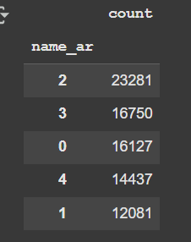
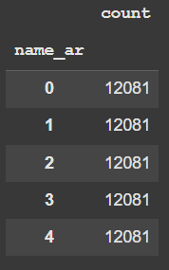
BALANCE DATA
Since the data was unbalanced and after dropping rows its also still unbalanced so I found the least target and made all other classes the same number of rows.

Slide 28
WORD REPRESENTATION TECHNIQUES

Slide 29
WORD REPRESENTATION TECHNIQUES
SKIP-GRAM
CBOW
Skip-gram is a traditional word embedding technique that learns to predict surrounding context words given a single target word. It produces static word vectors and is especially effective for capturing semantic relationships in rare or specific terms—a useful trait for medical applications. In the project, Skip-gram with the LSTM achieved the highest accuracy (0.90) among all embedding types, because of word-focused embeddings which worked well with sequence models. However, it is slower to train than CBOW and less robust to noise or out-of-vocabulary tokens.
CBOW predicts a target word based on its surrounding context words, creating embeddings by averaging context vectors. This makes it computationally efficient and good at handling frequent terms. In the project, CBOW performed strongly with logistic regression (accuracy 0.89) but slightly underperformed Skip-gram when combined with LSTM. Its smoothed representations are beneficial for traditional models, but they lose token-level detail, making CBOW less effective for deep sequential architectures like RNNs.

Slide 30
WORD REPRESENTATION TECHNIQUES
FAST TEXT
ARABERT
FastText extends CBOW/Skip-gram by representing words as combinations of character n-grams, allowing it to handle typos, unseen words, and morphologically rich languages like Arabic. It performed best overall in the project with LSTM reaching 0.9002 accuracy, showing its robustness to noisy, real-world medical text. FastText captures subword information and generalizes well, making it an ideal choice for user-generated content, though it still produces static embeddings without full sentence context. Its trained on Arabic webpages, Wikipedia articles, Forums, news, blogs — diverse, noisy, real-world text.
A deep transformer model that uses self-attention to understand the full sentence context. Generates contextual embeddings—each word’s meaning adapts based on surrounding words. AraBERT excels in tasks that require rich sentence-level understanding, but for short, noisy queries, simpler embeddings like FastText performed better.

Slide 31
Feature | Skip-gram | CBOW | FastText | AraBERT
Type | Traditional (shallow neural) | Traditional (shallow neural) | Pretrained embeddings | Pretrained Transformer-based embeddings
Contextual Understanding | No | No | No (static, subword-aware) | Yes
Handles Rare Words & Typos | Poor | Poor | Excellent (uses subwords) | Good (WordPiece tokenization)
Embeddings Nature | Static | Static | Static + Subword | Contextual (sentence-aware)
Language Support | General (language-agnostic) | General (language-agnostic) | Arabic-specific | Arabic-specific (MSA + dialectal)
Computational Cost | Low | Low | Medium | High
Training Speed | Fast | Very Fast | Fast (pretrained) | Slow (encoding + memory)
Best Model Results | Logistic Regression (0.86) | Logistic Regression (0.89) | LSTM (0.9002) | LSTM (0.8578)

Slide 32
COMPARE WORD REPRESENTATION TECHNIQUES
Word Embeding | Type | Best Test Accuracy | Best F1-score
Skip-gram | Traditional | 0.86 | 0.9
CBOW | Traditional | 0.89 | 0.89
FastText | Pretrained | 0.9002 | 0.90
AraBERT | Pretrained | 0.8578 | 0.85

Slide 33
SKIP-GRAM
Skip-gram produced high-quality, precise word embeddings by learning relationships between individual words and their contexts. It performed especially well with LSTM (accuracy: 0.90), showing its effectiveness in capturing medical terms and distinguishing between symptom-based queries. Its ability to generate strong embeddings for rare or domain-specific words made it highly effective in this setting. However, it is less robust to noisy or misspelled inputs. Best used for structured learning of domain terms.

Slide 34
CBOW
CBOW, while faster and efficient, smooths context too much by averaging it, which weakens its ability to capture fine-grained semantic distinctions—critical in medical classification. Although it performed well with traditional models like Logistic Regression (accuracy: 0.89), it slightly underperformed with sequential models due to lack of token-level precision.

Slide 35
FAST TEXT
FastText was the most effective technique overall (accuracy: 0.9002 with LSTM). Its use of subword information made it robust to misspellings, morphological variations, and unseen medical terms. This is ideal for real-world medical questions, where users frequently use informal or typo-prone language. It also required less computational power than transformer models.

Slide 36
ARABERT
AraBERT offered rich contextual embeddings and was capable of understanding sentence-level meaning. However, in this project, it slightly underperformed (accuracy: 0.8578 with LSTM), partly due to the short average sentence length (13 tokens) and the computational constraints that limited training to only 30k rows. While powerful in theory, its advantages weren't fully realized in this specific real-world scenario.

Slide 37
WORD REPRESENTATION TECHNIQUES
Why does Skip-Gram have better results than CBOW?
Skip-gram learns embeddings by focusing on individual words predicting their context. This results in richer, more distinct word vectors.
CBOW embeddings are the result of averaging context which is good for smoothing but bad for precise sequence modeling.
Skip-gram’s ability to handle rare or specific terms (e.g., drug names, symptoms) which helps learn discriminative patterns more effectively.
Skip-gram treats each center word independently, the model learns a focused vector per word.

Slide 38
WORD REPRESENTATION TECHNIQUES
Why does Fast Text have better results than AraBert?
Usually, AraBert should outperform Fast Text, but I had to use only 30 rows in AraBert and a token length of 16, because longer sequences and large datasets significantly increase GPU memory usage. However, if all the data were used and the input length were larger, the results would be better.
FastText represents words as character n-grams, allowing it to handle misspellings, morphological variations, and rare words more effectively, and understand root-based relationships (e.g., "طبيب", "طبيبة", "طب") better than models relying on whole-word tokens.
FastText produces consistent, static embeddings that are easy to use.
FastText is more robust to tokenization inconsistencies, dialect mixing, and partial translations. AraBERT, being a deep transformer, is more sensitive to input formatting, special tokens, and sentence length.

Slide 39
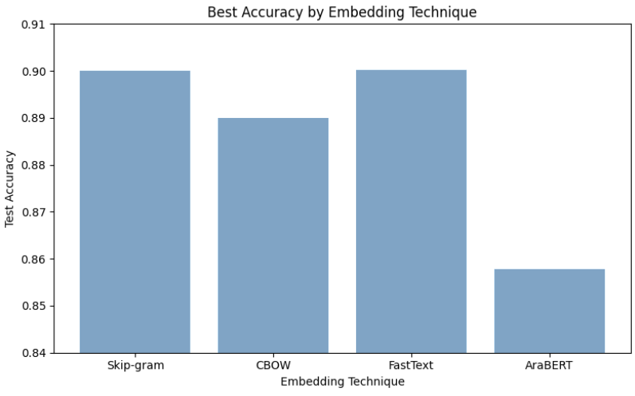

Slide 40
NLP MODELS

Slide 41
NAIVE BAYES
Strengths:
Very fast and simple to implement.
Performs well with TF-IDF or Bag-of-Words features.
Effective for short, sparse text data
Weaknesses:
Assumes feature independence, which is unrealistic in natural language.
Fails to capture word order or semantic context.
Performs poorly with dense embeddings like FastText or BERT.
Performance:
Best with CBOW (Accuracy: 0.84), worst with FastText (Accuracy: 0.67).
Not suitable for contextual or subword-aware embeddings

Slide 42
LOGISTIC REGRESSION
Strengths:
Strong performance with well-separated embeddings (e.g., CBOW, Skip-gram).
Easy to interpret and quick to train.
Robust to overfitting with regularization.
Weaknesses:
Cannot model word sequence or temporal dependencies.
Less effective with contextual embeddings like BERT unless adapted properly.
Performance:
Best with CBOW (Accuracy: 0.89), good with FastText (0.87) and Skip-gram (0.86).

Slide 43
RECURRENT NEURAL NETWORK (RNN)
Strengths:
Can handle sequential data, preserving word order.
More powerful than NB or LR for sentence-based modeling.
Weaknesses:
Suffers from vanishing gradients, limiting long-term dependency modeling.
Slower to train; less efficient with long texts.
Performance:
Best with Skip-gram (Accuracy: 0.892), consistent with CBOW and FastText (~0.88).

Slide 44
LONG SHORT-TERM MEMORY (LSTM)
Strengths:
Overcomes RNN limitations using gated memory units.
Captures long-term dependencies, ideal for sentence-level context.
Highly effective with detailed embeddings (Skip-gram, FastText).
Weaknesses:
More complex and resource-intensive to train.
Can be redundant when combined with deeply contextual embeddings like BERT.
Performance Insight:
Best overall with FastText (0.9002) and Skip-gram (0.90).
Underutilized with AraBERT (0.8578) due to short inputs

Slide 45
Model | Strengths | Weaknesses | Best Performance
Naïve Bayes | Fast, simple, good for sparse data | No context or order; poor with dense vectors | CBOW (0.84)
Logistic Regression | Robust, interpretable, works well with vectors | Ignores word order/context | CBOW (0.89)
RNN | Sequence modeling, order-aware | Vanishing gradients, slower | Skip-gram (0.892)
LSTM | Best for long-term dependencies, memory-aware | Heavier, slower, BERT-overlap | FastText (0.9002), Skip-gram (0.90)

Slide 46
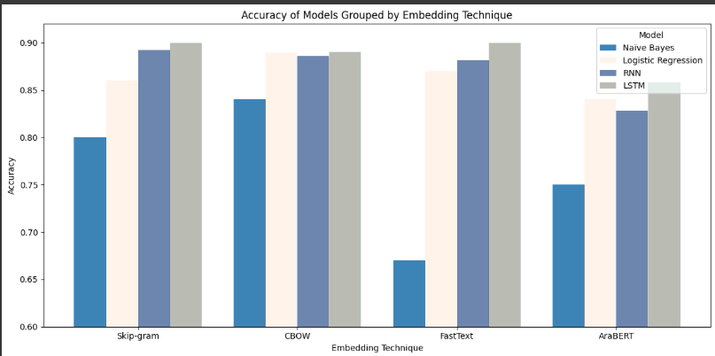

Slide 47
BEST RESULTS
FastText and LSTM model gives the best accuracy of 0.9002
FastText represents each word as a bag of character n-grams, it creates a word vector by summing the vectors of all subwords, this means even if a word is misspelled or unseen, FastText can still build a meaningful vector based on its parts. This helps because Arabic is morphologically rich, and users may write informal or misspelled words in questions, FastText’s subword modeling makes it robust to typos, dialectal forms, and rare medical terms, it produces dense, informative, and stable embeddings that improve downstream learning.
LSTMs can retain long-range dependencies and filter out irrelevant information using:
Forget Gate: Decides what to discard.
Input Gate: Controls what new information to store.
Output Gate: Determines what to pass to the next step.
This allows LSTMs to model word sequences effectively — capturing sentence flow, grammatical dependencies, and meaning transitions.

Slide 48
TRANSFORMERS

Slide 49
GPT TRANSFORMER
GPT (Generative Pretrained Transformer) is a unidirectional decoder transformer that generates text by predicting the next word in a sequence, relying only on left-to-right context. This makes GPT strong in generative tasks like language modeling or text completion, but less suited for classification, where full sentence-level understanding is crucial. GPT achieved 87.33% accuracy a strong performance but lower than AraBERT. This is likely due to its limited ability to consider future context during training, which restricts its capacity to fully understand the input's intent. GPT also had a slightly lower evaluation loss (0.461) than AraBERT, suggesting confident predictions, but these were not as accurate due to the model's architectural limitations for this specific task.

Slide 50
ARABERT TRANSFORMER
AraBERT is a bidirectional encoder transformer based on the original BERT architecture, specifically pretrained on large Arabic corpora, including news, Wikipedia, and web text. It uses the Masked Language Modeling (MLM) objective, allowing it to learn from both the left and right context of a word simultaneously. This deep bidirectional understanding makes it particularly effective for classification tasks, where grasping the full semantic context of a sentence is critical. In the project, AraBERT achieved an impressive accuracy of 90.07%, thanks to its ability to model short, formal medical questions in Arabic. Its Arabic-specific pretraining further enhanced its understanding of morphology and syntax, giving it an edge in identifying subtle differences in user input. AraBERT also processed inputs efficiently, completing evaluation faster than GPT. Giving it the best results in the project.

Slide 51

REFERENCES
Darwish, K. and Mubarak, H. (2016) FaRASa: a new fast and accurate Arabic word segmenter. https://aclanthology.org/L16-1170/?
Mustafa M. et. le., (2017), A Comparative Survey on Arabic Stemming: Approaches and
GeeksforGeeks (2025a) Continuous bag of words (CBOW) in NLP. https://www.geeksforgeeks.org/continuous-bag-of-words-cbow-in-nlp/.
Skip-Gram - Graph Analytics & Algorithms - ULTIPA Graph (no date). https://www.ultipa.com/docs/graph-analytics-algorithms/skip-gram#:~:text=The%20Skip%2Dgram%20(SG),Struc2Vec%20to%20generate%20node%20embeddings.
GeeksforGeeks (2025b) Introduction to recurrent neural networks. https://www.geeksforgeeks.org/introduction-to-recurrent-neural-network/.
GeeksforGeeks (2025) What is LSTM Long Short Term Memory? https://www.geeksforgeeks.org/deep-learning-introduction-to-long-short-term-memory/.
GeeksforGeeks (2025c) Naive Bayes classifiers. https://www.geeksforgeeks.org/naive-bayes-classifiers/.
GeeksforGeeks (2025c) Logistic regression in machine learning. https://www.geeksforgeeks.org/understanding-logistic-regression/.
GeeksforGeeks (2024) Word embeddings using FastText. https://www.geeksforgeeks.org/word-embeddings-using-fasttext/.

